Slide 1
Agenda
1. LLM Models intro
2. Prompt Engineering
3. VS Code, GitHub
4. Working with Popular models
5. Example use cases with AI
6. CLI, Workflow, Skills and other techniques
7. RAG
8. Deep dive use cases building real apps
9. Using Python and API mode using SDK
10. MCP Server
11. Building Agentic flow

Slide 2
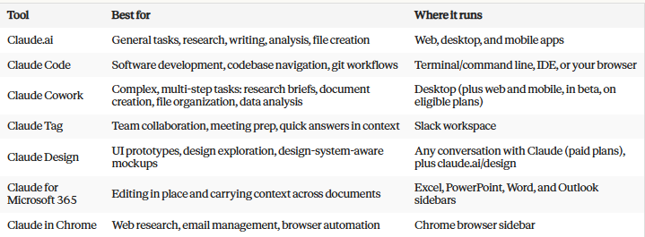
Entry points
https://anthropic.skilljar.com/claude-101
https://anthropic.skilljar.com/

Slide 3
API Demo

Slide 4
Prompt Engineering
https://www.codecademy.com/article/prompt-engineering-101-understanding-zero-shot-one-shot-and-few-shot
Classify the following statements as Positive or Negative
1. I liked the Movie
2. The food at the restaurant tasted bad
3. We visited the Movie and I got excited when the Closing credits appeared finally

Slide 5
Tools & MCP
https://anthropic.skilljar.com/claude-with-the-anthropic-api

Slide 6
RAG
https://anthropic.skilljar.com/claude-with-the-anthropic-api

Slide 7
Agentic AI Patterns
https://docs.cloud.google.com/architecture/choose-design-pattern-agentic-ai-system
Gemini with Python: https://www.philschmid.de/agentic-pattern
https://www.anthropic.com/engineering/building-effective-agents
https://resources.anthropic.com/hubfs/Building%20Effective%20AI%20Agents-%20Architecture%20Patterns%20and%20Implementation%20Frameworks.pdf

Slide 8
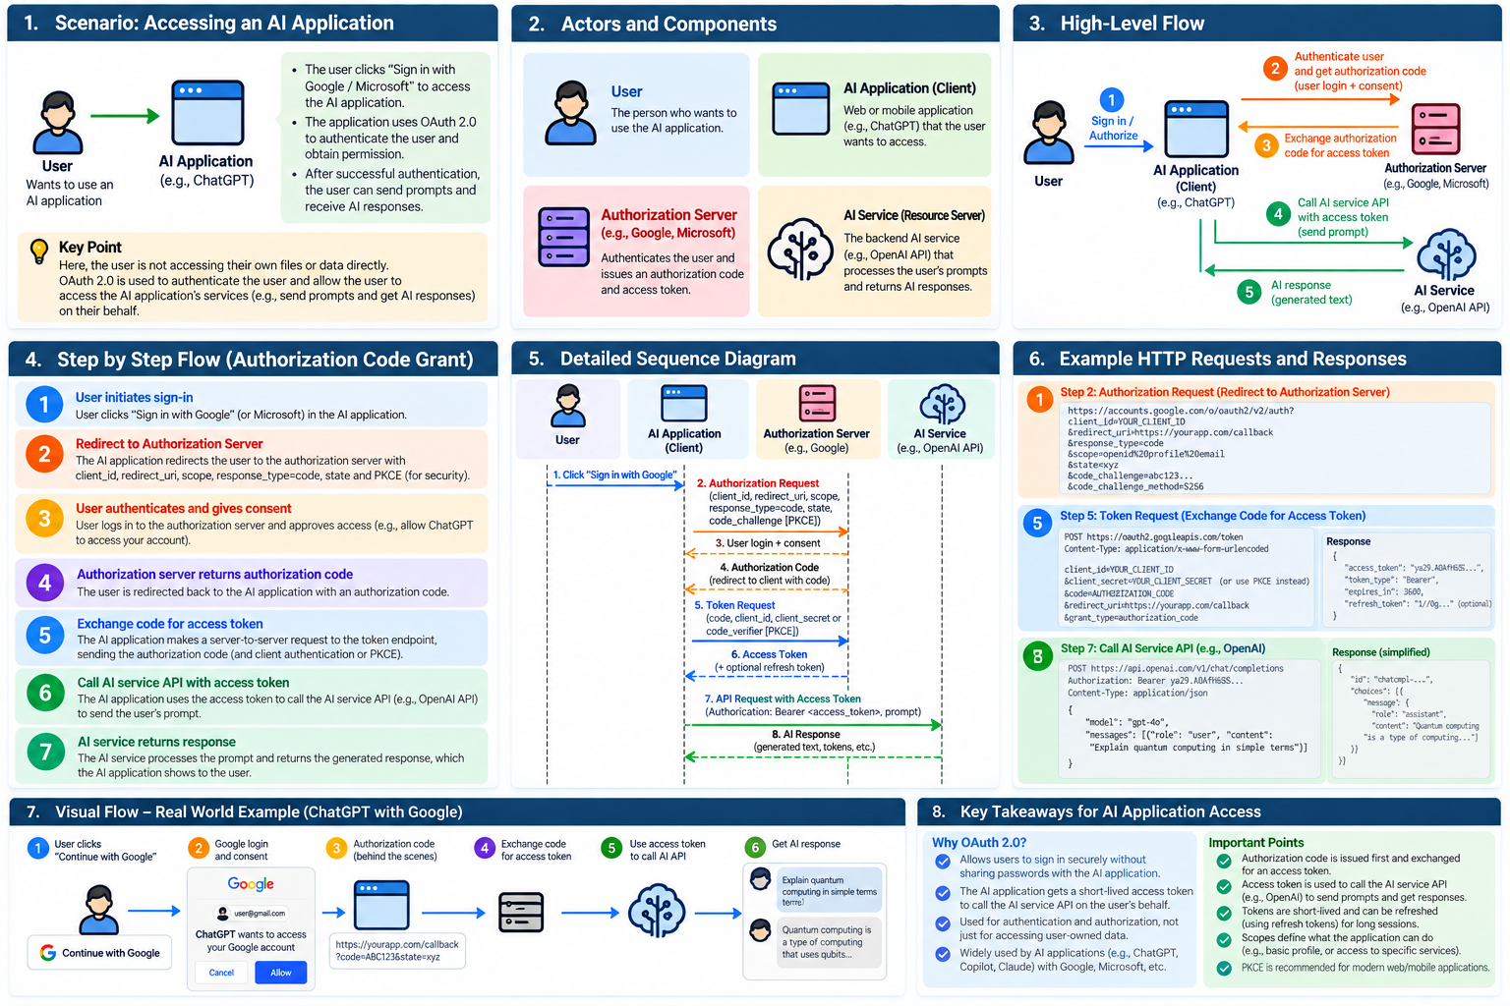
Authentication – Validating your identity → “Who are you?”
Authorization – Validating your access/permissions → “What are you allowed to do?”

